Slide 1
Reverse Engineering/Repair Development (RE/RD) Program
429 SCMS/GUMD
March 29, 2024

Slide 2
Classification
The classification of the brief is Unclassified, and the discussion can go up to Unclassified

Slide 3
448 SCMW RE/RD Plan
448 SCMW is investing in our Supply Chain
  Build supplier base
  Increase Competition
Able to use Working Capital Funds to create competition
  CSAG-S (AF Managed Items)
  GSD (DLA Managed Items)
Examples of Project Deliverables
  Prototype(s)
  Technical Data Package
  Overhaul/Repair Instructions
  Testing Qualifications
Enterprise Level (Robins, Tinker, Hill)
  Supporting the Supply Chain and System Program Offices

Slide 4
Next steps after Industry Day
  Interested vendors should request any data we own through the Public Sales Office (PSO).
    If the quad chart shows we own Engineering Drawings, vendors should request a tracking number from 429scms.saspo.workflow@us.af.mil prior to submitting your data request. Without this tracking number, vendors will be billed the PSOs hourly rate of $272/hr. The tracking number only applies to Engineering Drawings, not Technical Orders (TOs). TOs are $65/TO (?). This cost is set by the PSO, not the SASPO.
    Please go to our https://www.tinker.af.mil/Home/429SCMS-SASPO/ and follow the instructions located at the bottom of the vendor resources section on how to request data.
  Interested vendors should RSVP to attend Technical Discussion with the Integrated Product Team (IPT), see chart B on the quad chart for details.
  Submit White Paper within 60 days of Industry Day to 429scms.saspo.workflow@us.af.mil.

Slide 5
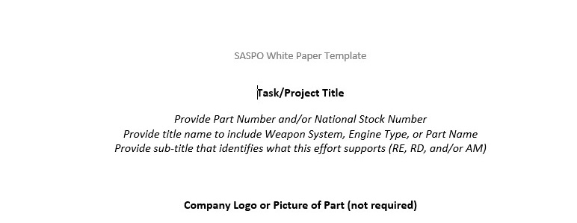
White Paper Guidelines
Purpose – To serve as Market Research, not a formal bid or proposal.
  Assist the IPT with project development
  Receive engineering feedback
EXAMPLE: https://www.tinker.af.mil/Home/429SCMS-SASPO/
Vendor Resources: White Paper Template

Slide 6
Contracting Vehicle
Other Transaction Authority (OTA)
  Contract/Agreement Awarded September 2019 (?)
  SOSSEC (System of Systems Consortium)
  $99M Ceiling over ten years
  Must be a member to participate ($500 Annual Fee)
  https://sossecinc.com/sossec-home
Other contract vehicles managed outside of SASPO can/will be used also

Slide 7
Future Opportunities
Industry Days are advertised on SAM.gov and SASPO Website
  Robins AFB Industry Day – March
  Tinker AFB Industry Day – August
  Hill AFB Industry Day – December
Please check the SASPO Website under SASPO Hosted Events for RSVP instructions and details.

Slide 8

Questions

